Slide 1












-ADRIENNE RICH

Slide 2




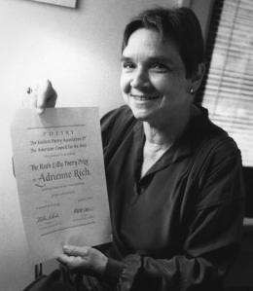

ADRIENNE RICH

Slide 3

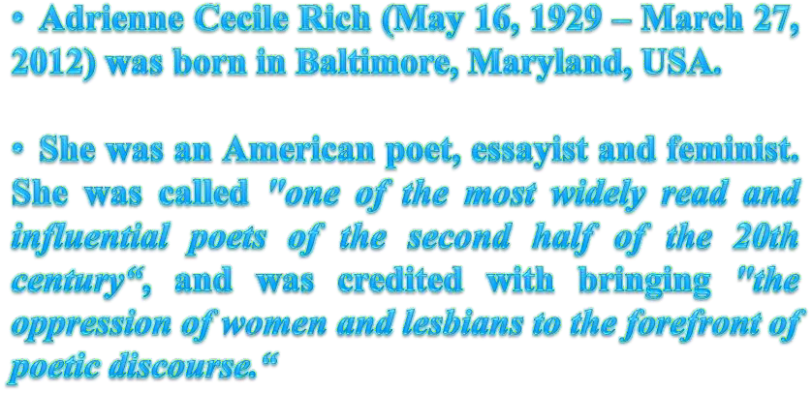

Slide 4


























































































































































Slide 5














































































































Slide 6






















































































































Slide 7





Slide 8






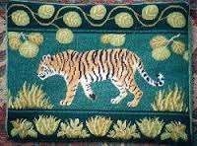





Slide 9





Slide 10





Slide 11


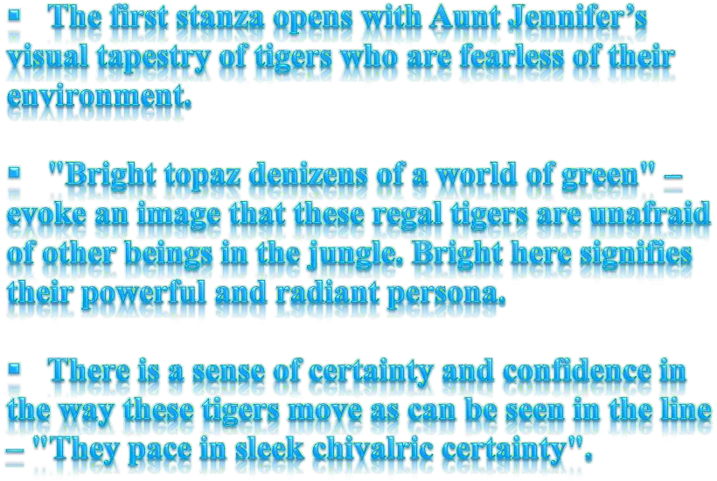

Slide 12




Slide 13


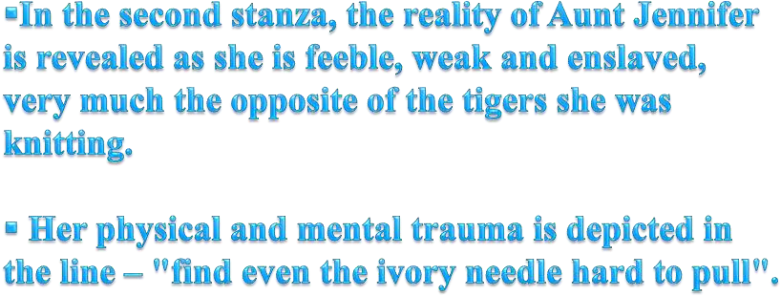
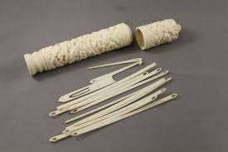

Slide 14




Slide 15




Slide 16

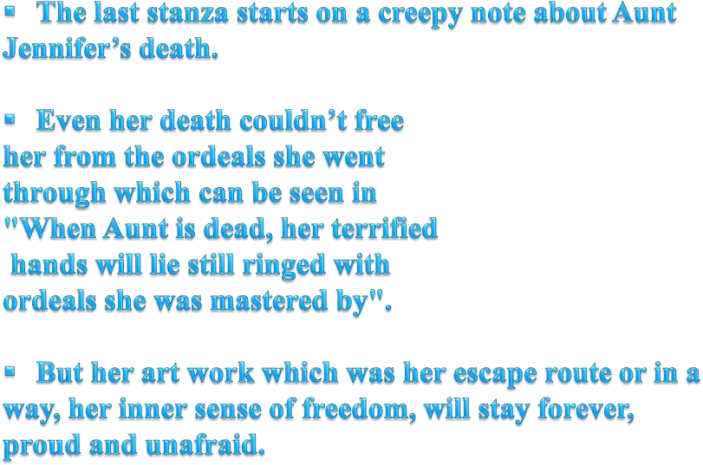


Slide 17



Slide 18


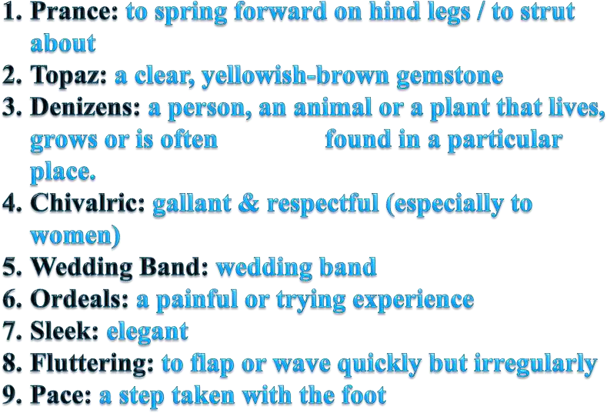

Slide 19

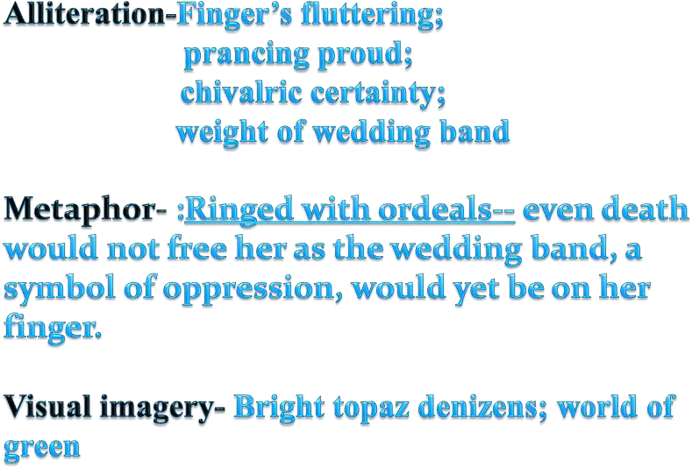

Slide 20

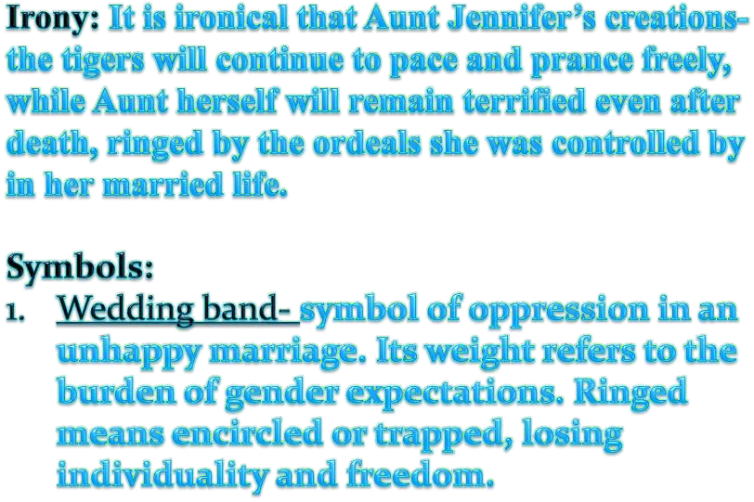

Slide 21

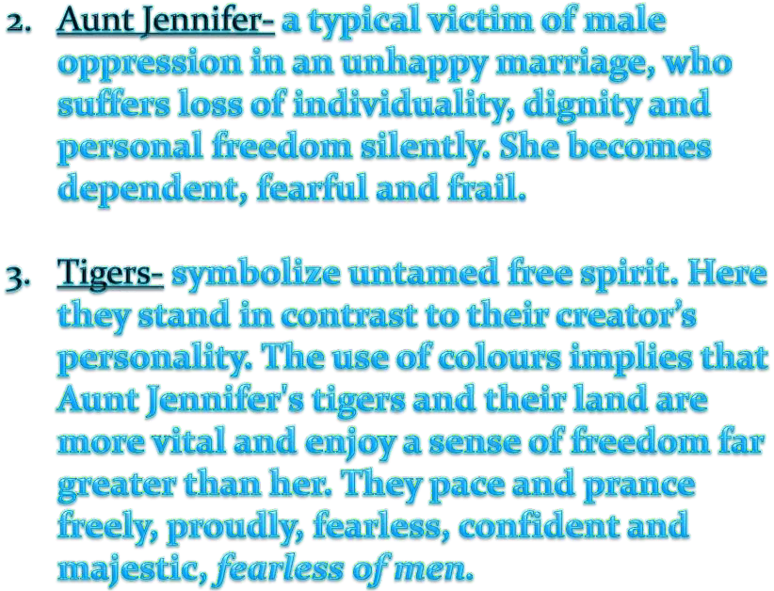

Slide 22









































Yellow (bright topaz)
green
Embroidery-
7. Aunt (last stanza) –

Slide 23





